Slide 1

An Introduction to Quantum Computing
Archit Chadalawada
General Secretary of QuantUs, MITB

Slide 2
Contents
What is Quantum Computing?
Essential Maths Crash Course
Qubits
Quantum Gates & Circuits
Basics of Qiskit
Conclusion

Slide 3

What is Quantum Computing?

Slide 4
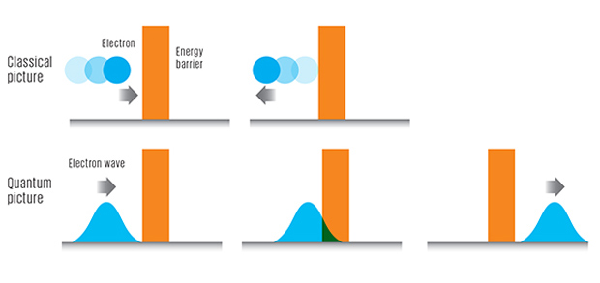
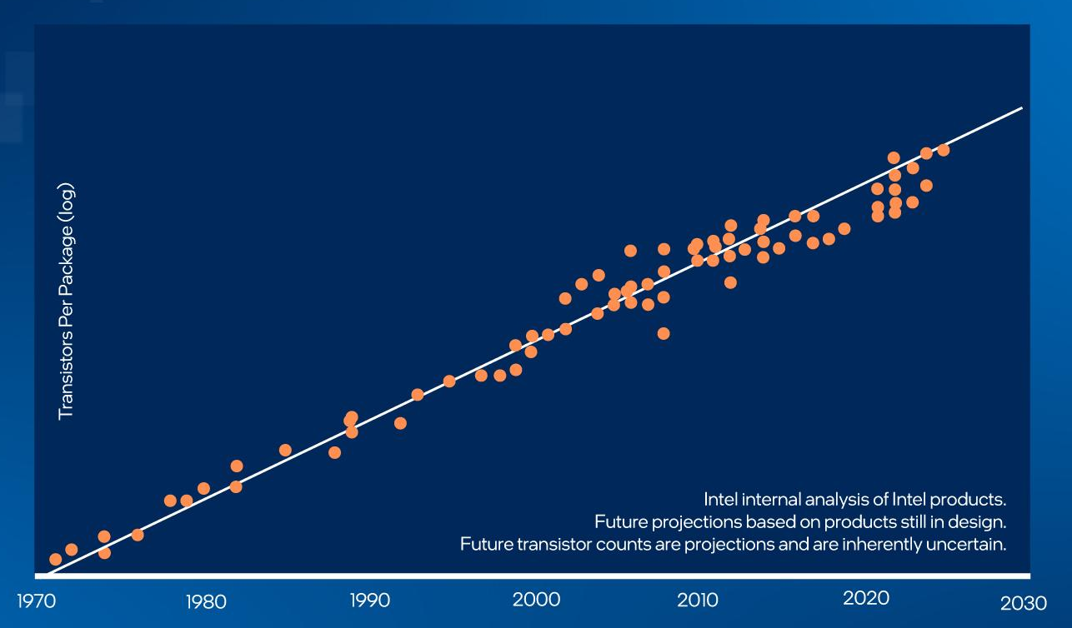
The Limits of Classical Computation
Moore’s law
Quantum tunnelling
(1nm)
Feynman’s idea
(1981)

Slide 5
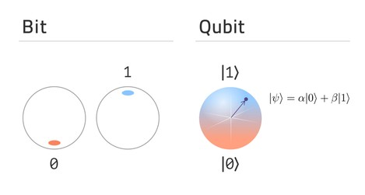
Differences Between Classical and Quantum Computers
Bits vs Qubits
Deterministic vs probabilistic measurement

Slide 6
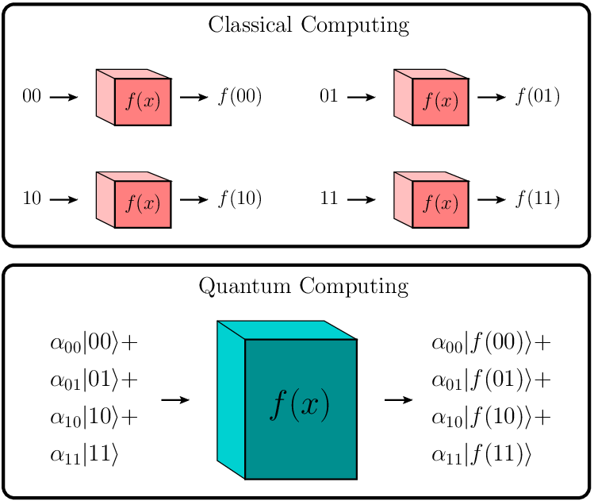
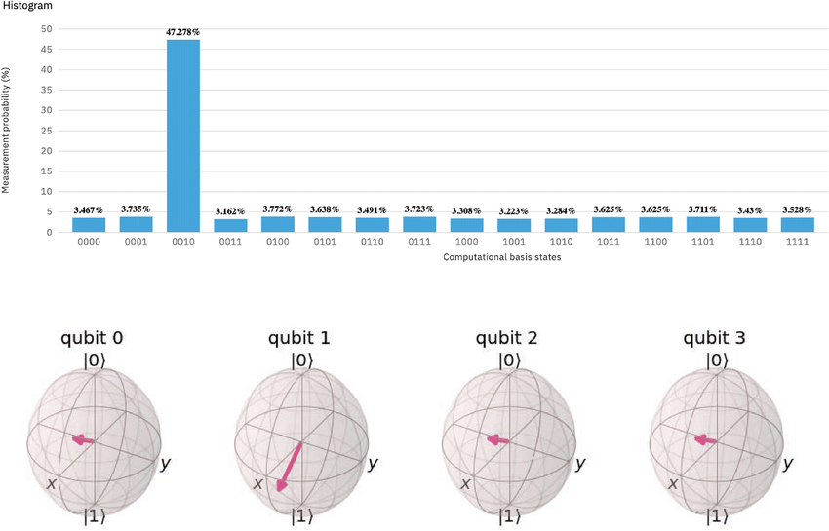
Quantum parallelism
Interference: Playing with probabilities

Slide 7

Math Crash Course

Slide 8
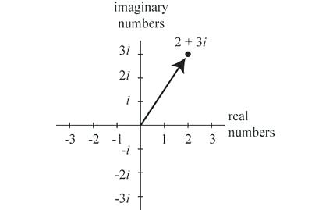
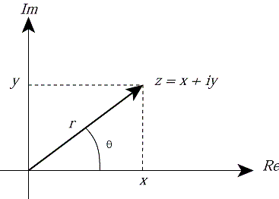
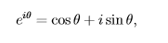
Complex Numbers

Slide 9
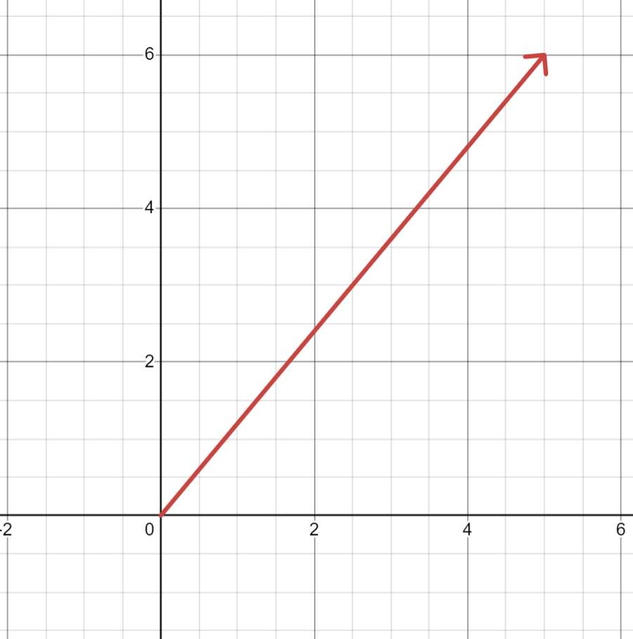

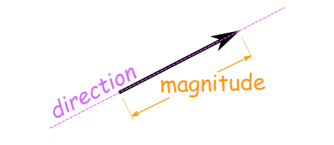
Vectors

Slide 10
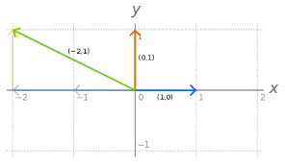

Basis Vectors
$$V=−2∗ \hat{i}+1∗\hat{j}$$

Slide 11
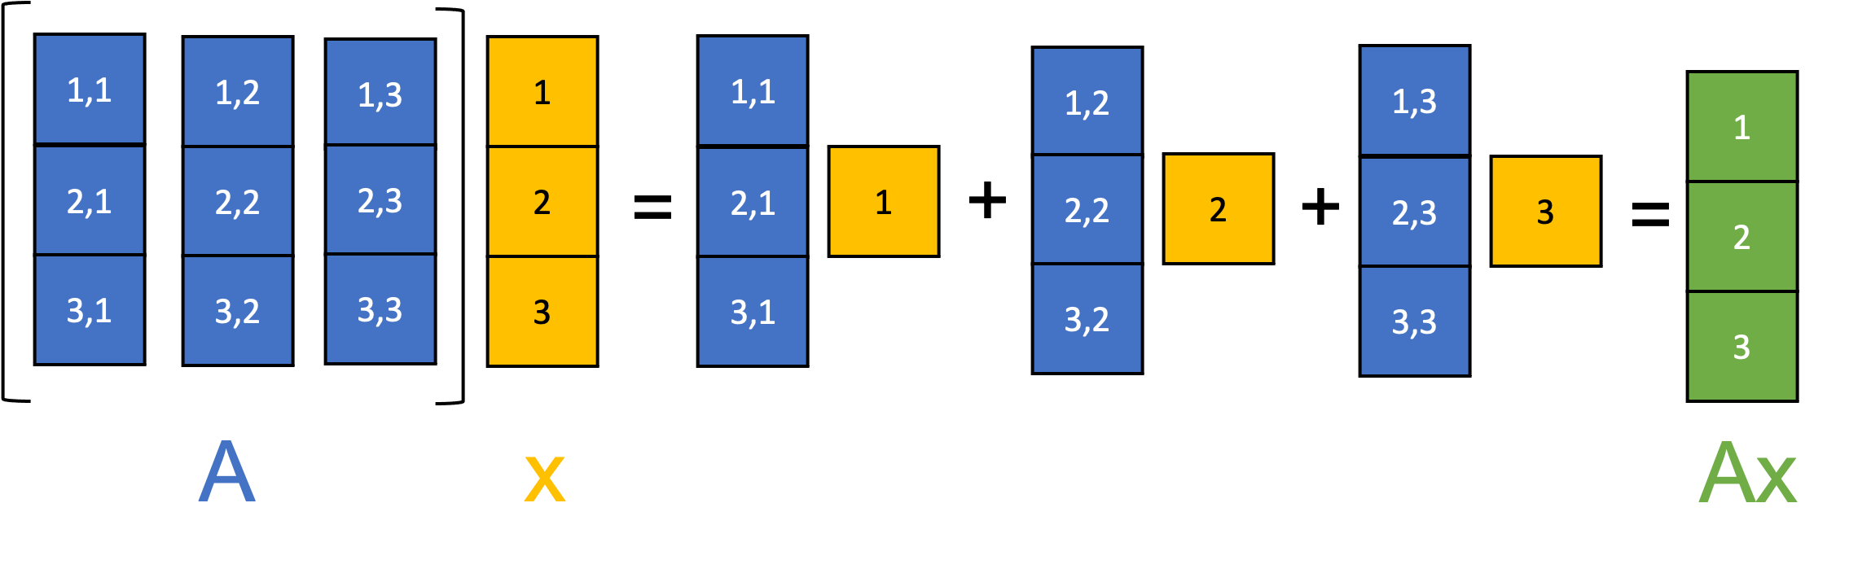
Matrix Multiplication

Slide 12
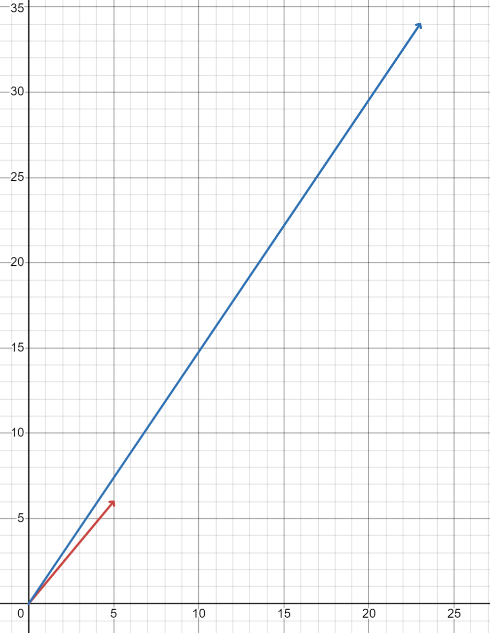
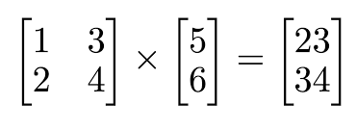
Matrices as Linear Transformations

Slide 13
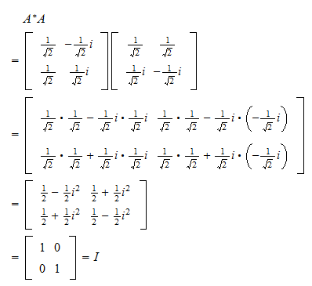
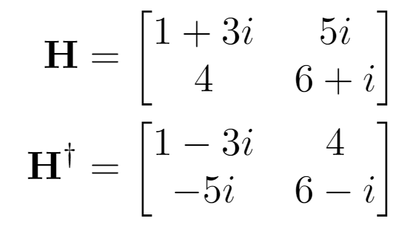
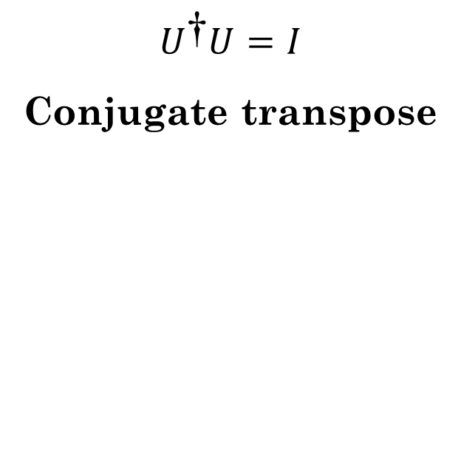
Unitary Matrices
$$U^{\text{†}}U=I$$
Conjugate transpose

Slide 14
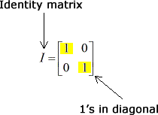

Hermitian Matrices
${U=U}^{\text{†}}$
If both, Unitary and Hermitian?
$U^{\text{†}}U=I$
UU = I
U is its own inverse!

Slide 15

Qubits

Slide 16
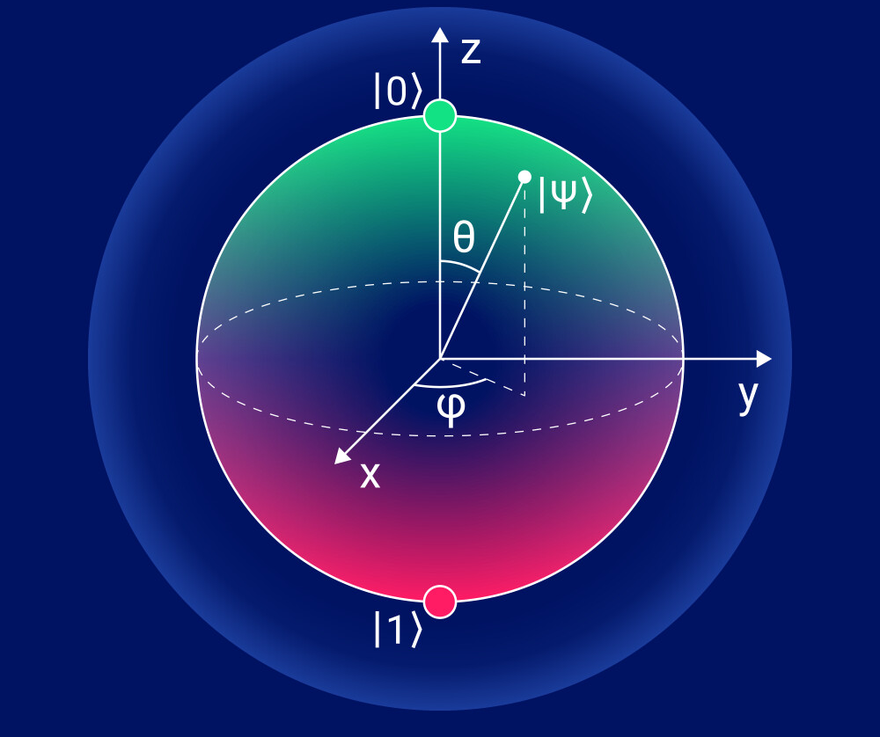
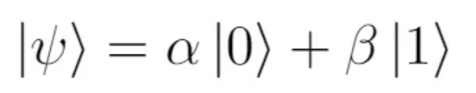


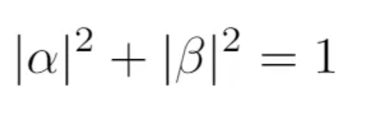
What is a Qubit
P(0) =
P(1) =

Slide 17
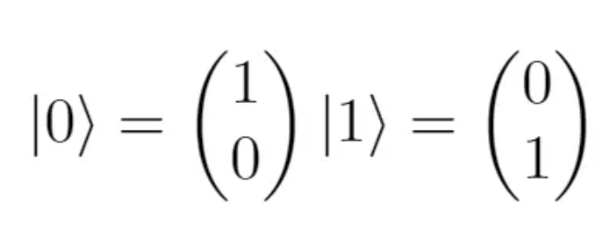
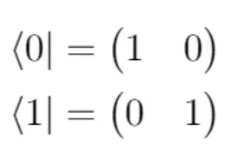
Dirac Notation
Ket Bra

Slide 18
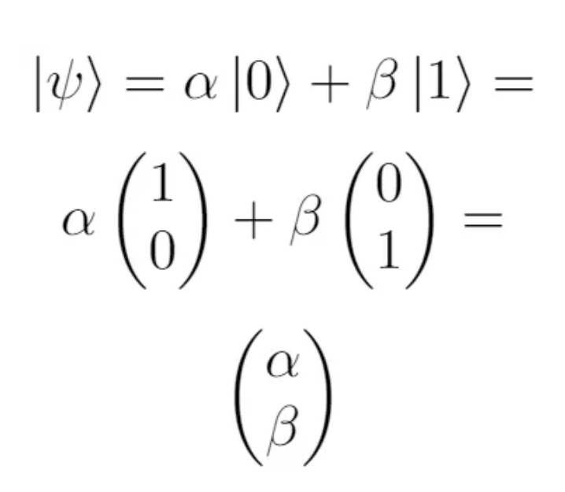
Dirac Notation

Slide 19
The Bloch Sphere
Amplitudes (Probabilities)
Phases (Between |0> and |1>)

Slide 20
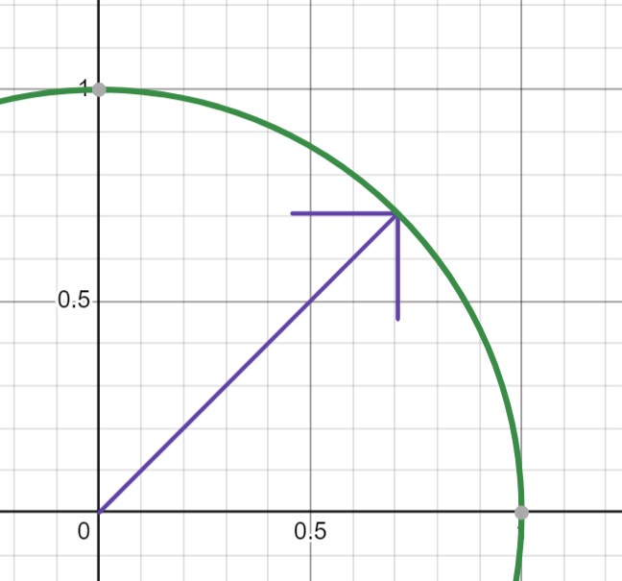


Representing Amplitudes
$$|0\text{⟩}$$
$$|\text{1}\text{⟩}$$

Slide 21
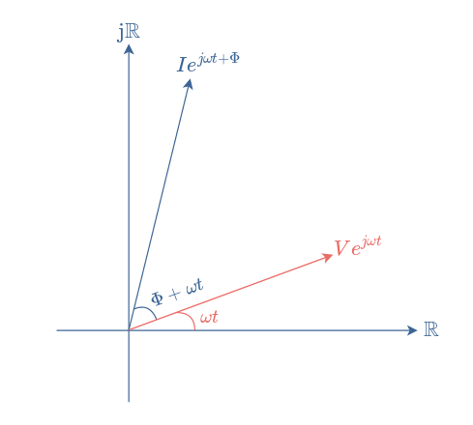


Representing Phase (Global vs Relative Phase)
$$|\text{1}\text{⟩}$$
$$|0\text{⟩}$$

Slide 22
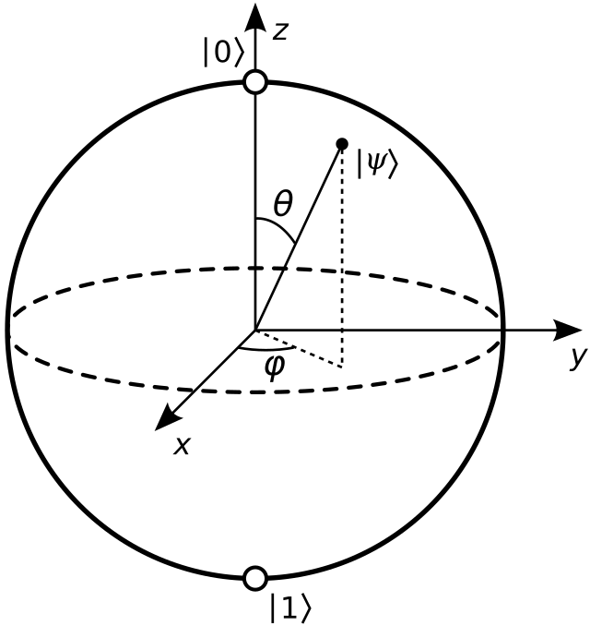

Putting it together (the formal Bloch sphere)
$\text{|}\text{ψ}\text{〉}\text{=} \text{cos}\left(\frac{\text{θ}}{\text{2}}\right)\text{|0}\text{〉}\text{+}{ e}^{\text{i}\text{ϕ}}\text{sin}\left(\frac{\text{θ}}{\text{2}}\right)\text{|1〉}$

Slide 23
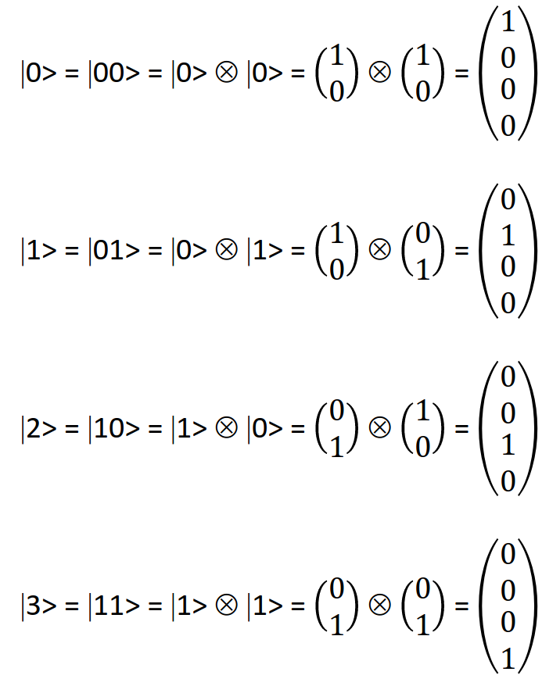
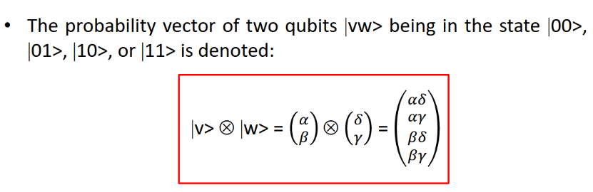
Multiple qubits? Tensor products

Slide 24
Quantum Gates & Circuits

Slide 25
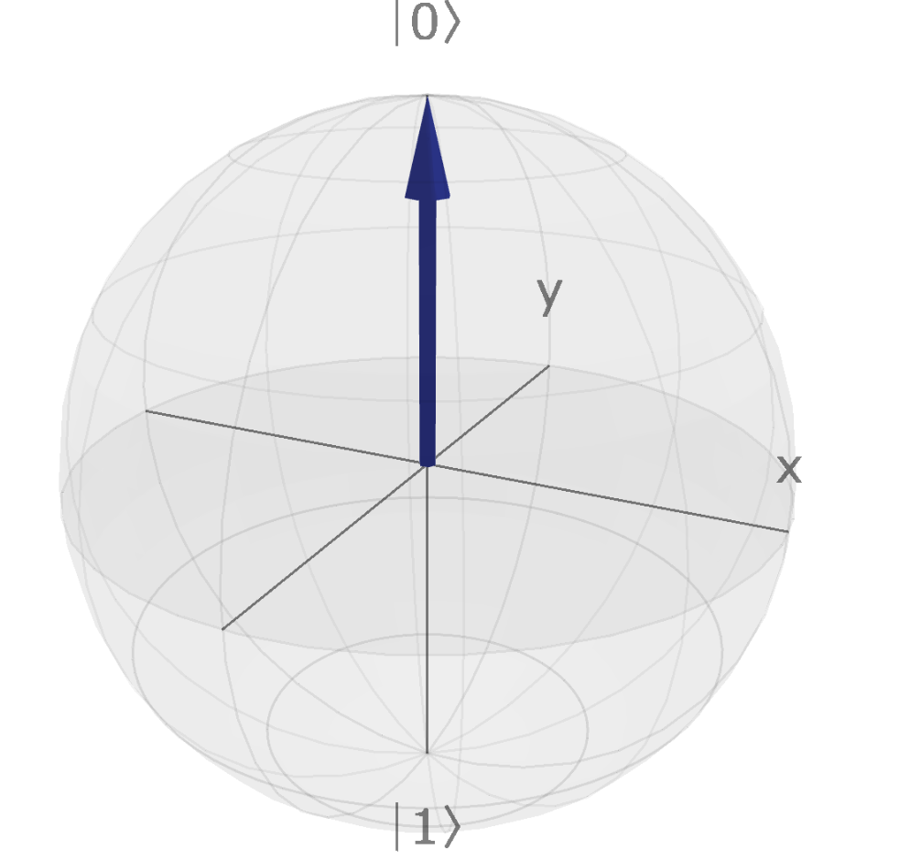
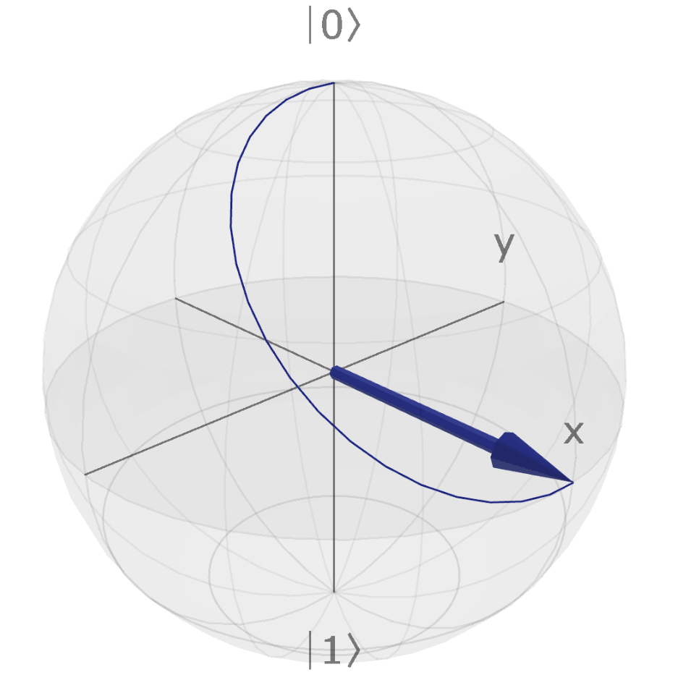


Quantum Gates/ Operations
Unitary operation on qubit state vectors (normalization)
Transform one qubit state into another (Bloch sphere)

Slide 26

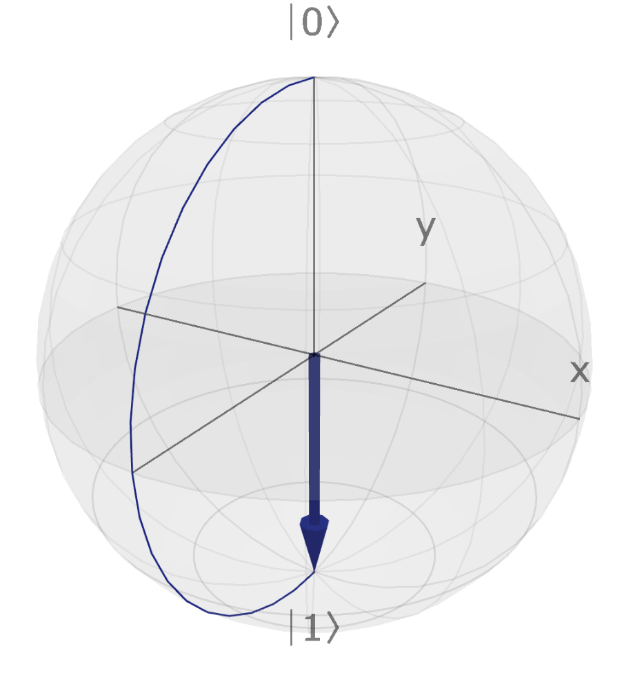
X Gate (Bit Flip/ NOT Gate)

Slide 27

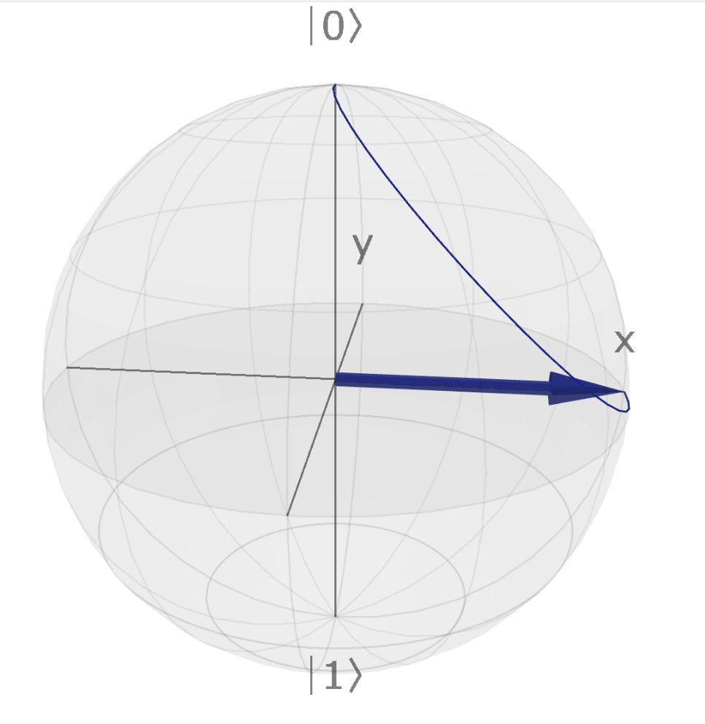
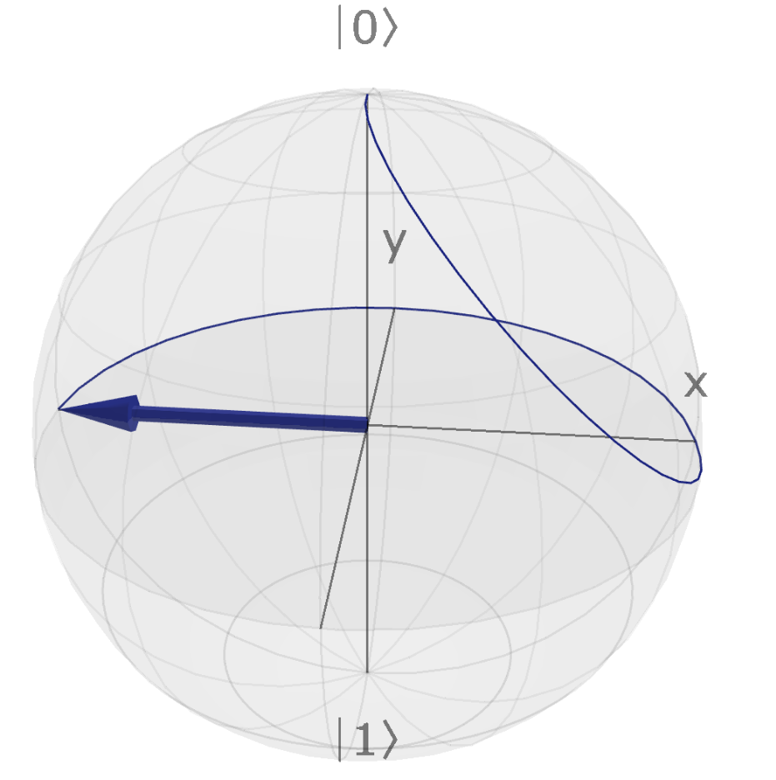
Z Gate (Phase Flip)

Slide 28

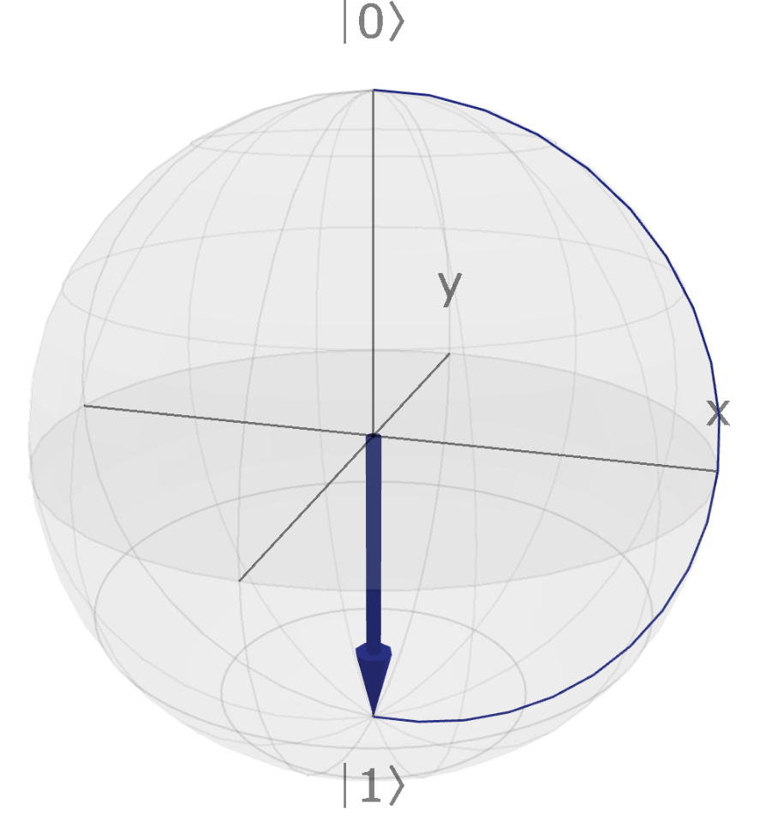
Y Gate

Slide 29

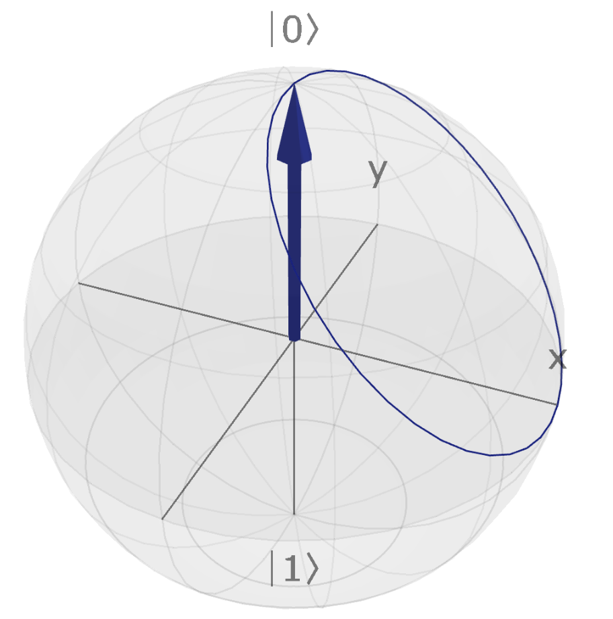
Hadamard Gate

Slide 30

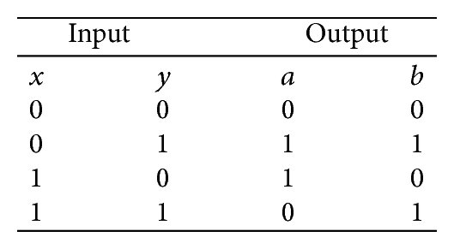
CNOT Gate (Entanglement)

Slide 31
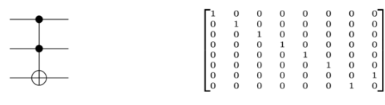
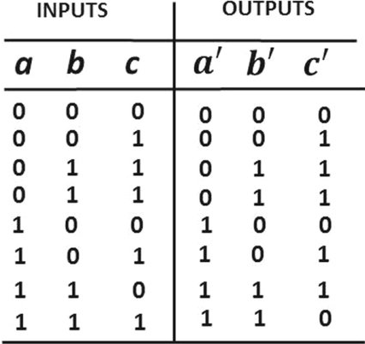
Toffoli Gate

Slide 32
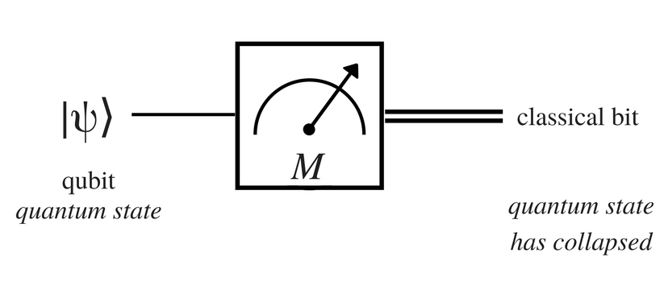
Measurement
Reversible vs irreverible

Slide 33
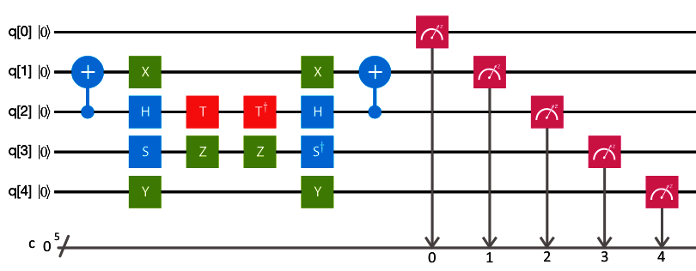
Quantum Circuits
Combination of Quantum gates applied on qubits:

Slide 34
Introduction to Qiskit
LET’S CODE!!!

Slide 35

Q&A

Slide 36
References
https://www.google.com/url?sa=i&url=https%3A%2F%2Fwww.intel.com%2Fcontent%2Fwww%2Fus%2Fen%2Fnewsroom%2Fresources%2Fmoores-law.html&psig=AOvVaw2VwJIf8DnL8uv_kanNM-8T&ust=1723358598846000&source=images&cd=vfe&opi=89978449&ved=0CBEQjRxqFwoTCNjBg5zp6YcDFQAAAAAdAAAAABA0
https://assets.rbl.ms/25573589/origin.jpg

